Slide 1
Assignment 2 Presentation

Slide 2
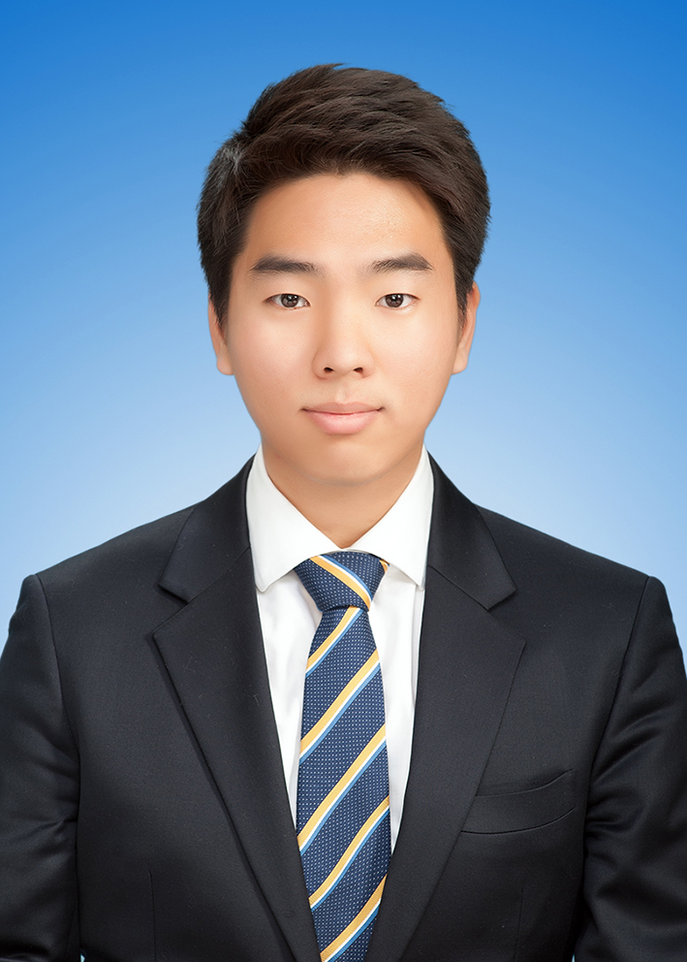

Group Tue 12i - Members
John (Min Jae), Kim
MinJae.Kim@anu.edu.au
Si Bo, Hu
u7271125@anu.edu.au
- Code structure design
- Back-end design
- Code structure design
- Front-end design

Slide 3
Table of Contents
Starting Game
Game Playing
Further Improvements

Slide 4
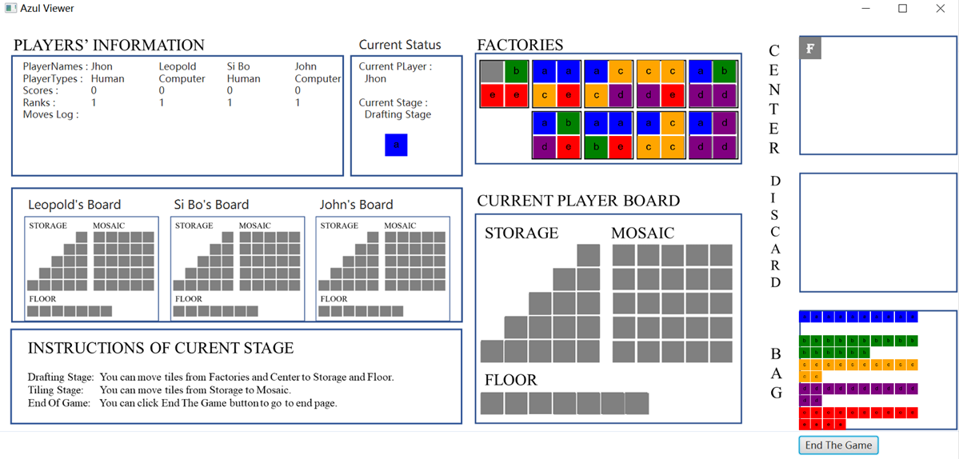
Starting Game

Slide 5
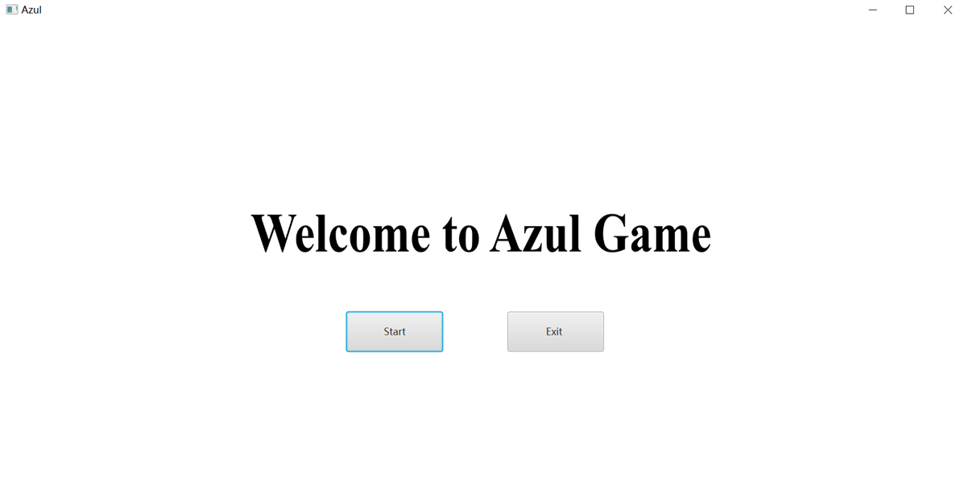
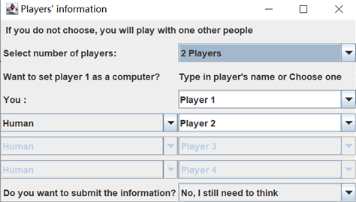
Starting Game
Game Start
Starting Page
Player Setting

Slide 6
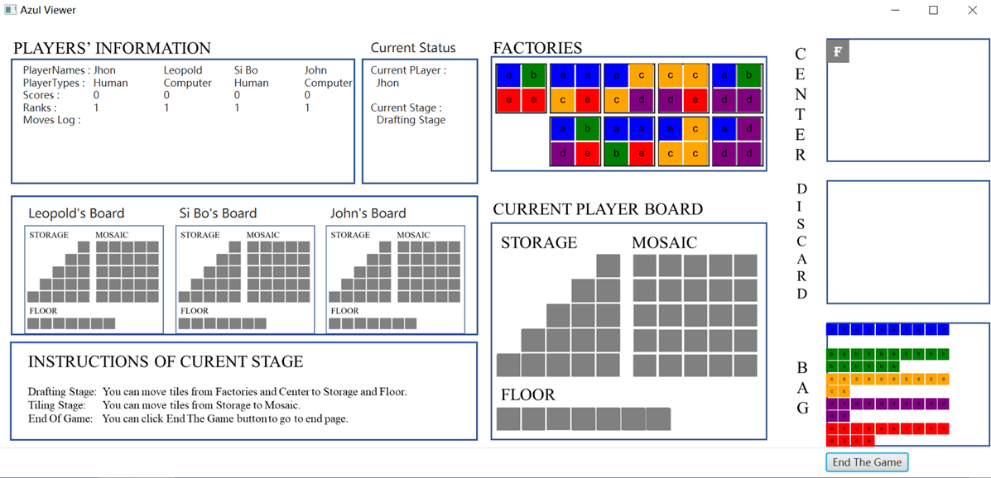
Starting Game
Three main parts of Azul Viewer
Player's Information
Other Players' Board
Current Player Board

Slide 7
Starting Game
Player's Information
Player Names
Player Types
Scores
Ranks
Move
Current Status
Current Player
Current Stage
Drafting Stage
Tiling Stage
End of Game

Slide 8
Starting Game
Other Players Board
Each players status
Not snappable
Only display
Current Players Board
Snappable or draggable

Slide 9
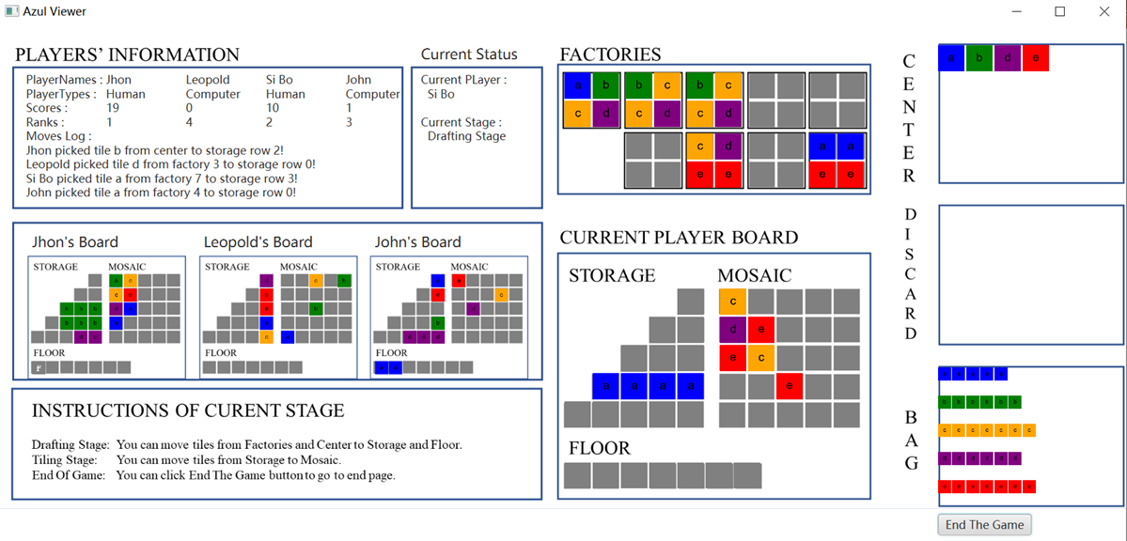
Game Playing

Slide 10
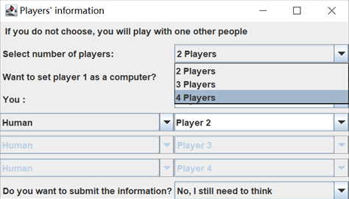
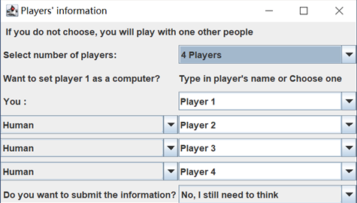
Game Playing – Player Setting
Select number of players
3rd, 4th player setting enabled

Slide 11
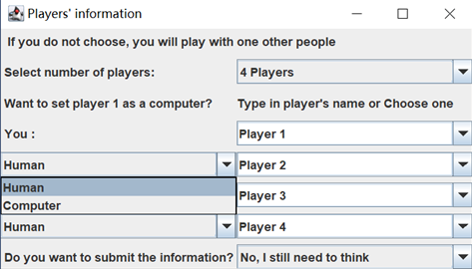
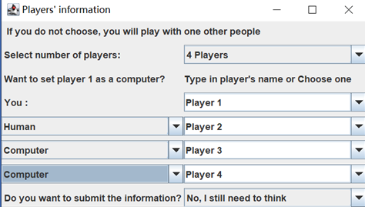
Game Playing – Player Setting
Select type of players
Setting for each players

Slide 12
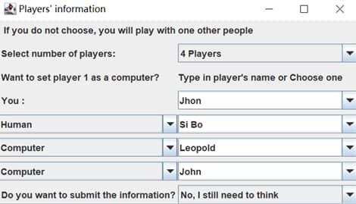
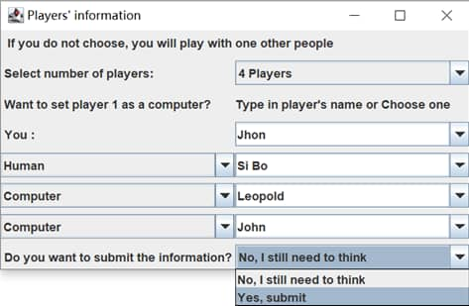
Game Playing – Player Setting
Type in name of player
Finalize setting

Slide 13
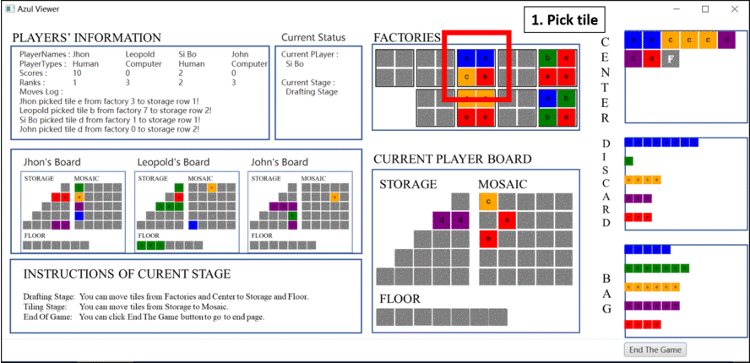
Game Playing – Drafting Move Restore

Slide 14
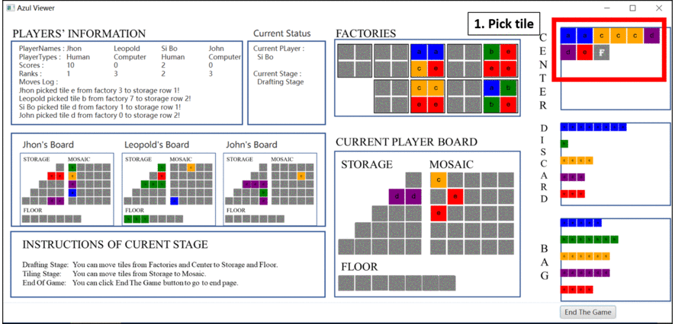
Game Playing – Invalid Drafting Move

Slide 15

Game Playing – Valid Drafting Move

Slide 16
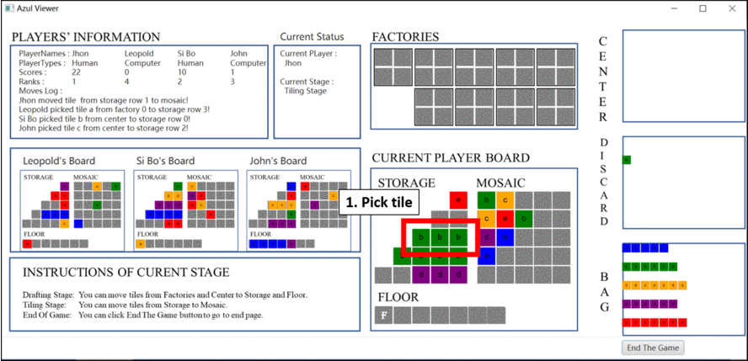
Game Playing – Invalid Tiling Move

Slide 17
Game Playing – Valid Tiling Move

Slide 18
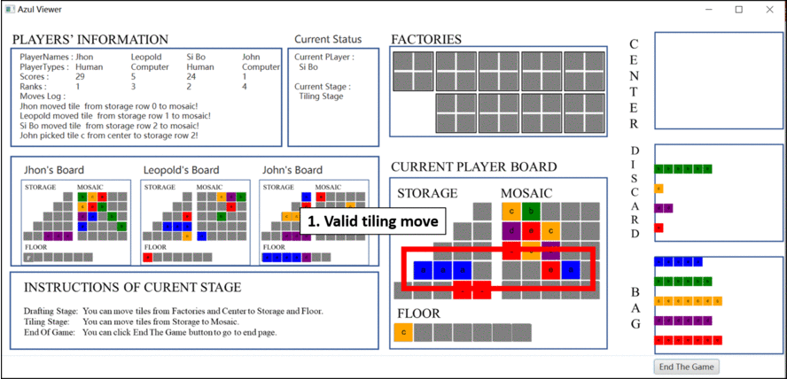
Game Playing – Preparing Next Round

Slide 19
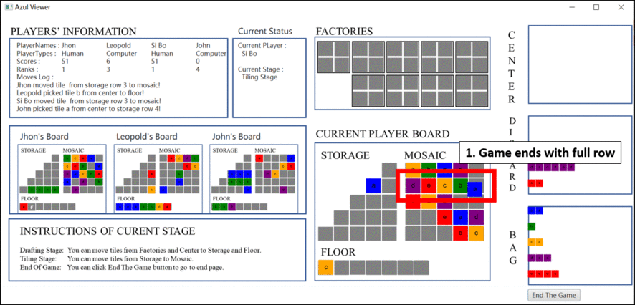
Game Playing – End of Game

Slide 20
Further Improvements
c
b
A's
Smart
Move
e
e
e
e
Pruning

Slide 21
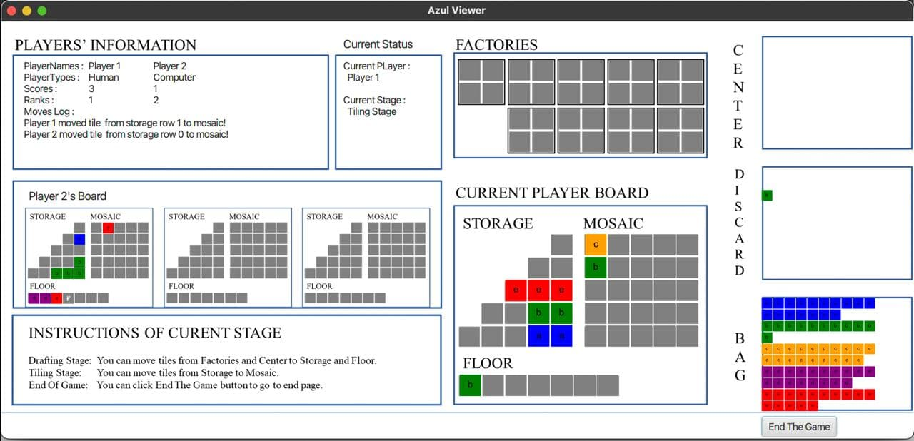
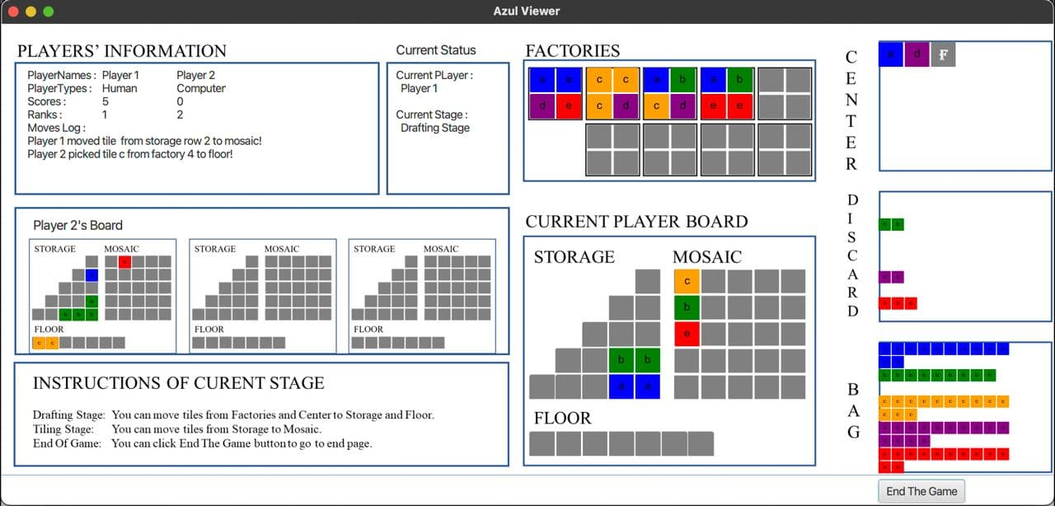
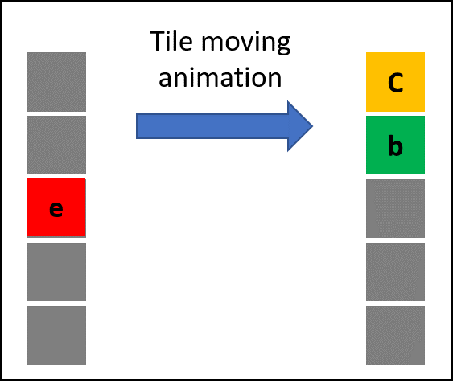
Further Improvements
Enhanced user interface
Show tile movement from start to the end

Slide 22
Further Improvements
Enhanced user interface
Display how many scores increased by the action
Show score increment
+3
-1

Slide 23
Further Improvements
Enhanced computer opponent
Make tree of every possible movement and calculate score
Use recursive method to find smart move
A's
Highest
Score
A's
Smart
Move
...
.
.
.

Slide 24
Further Improvements
Enhanced computer opponent
Advanced search algorithm with alpha-beta pruning algorithm
A's turn
Maximize A's Score
Minimize A's
Score
Not A's turn
Minimize A's Score
Maximize A's
Score
A's
Possible
Highest Score
A's
Smart
Move
...
.
.
.
Pruning

Slide 25

Questions and Answers

